Slide 1
USE OF HIGH-RESOLUTION IMAGE DATA OUTPERFORMS VEGETATION INDICES IN PREDICTION OF MAIZE YIELD
Aguate F., Trachsel S., Burgueño J., Crossa J., Balzarini M. & de los Campos G.

Slide 2
Outline
Introduction
Objectives
Data description
Methods
Results
Conclusions
Acknowledgments

Slide 3
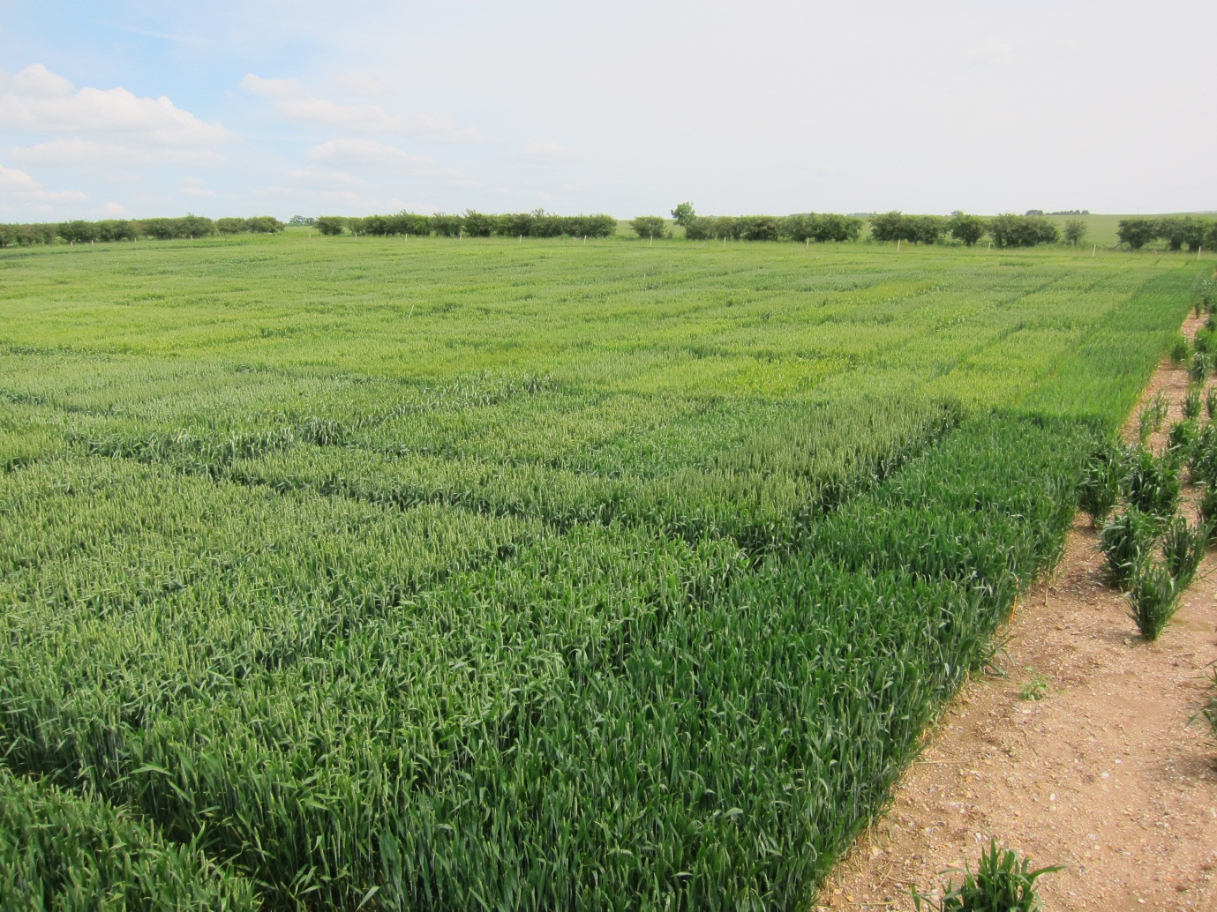
Introduction

Slide 4






Introduction
$${\hat{y}}_{4}$$
$${\hat{y}}_{5}$$
$${\hat{y}}_{1}$$
$${\hat{y}}_{2}$$
$${\hat{y}}_{3}$$
y
$$\hat{y}$$

Slide 5

Introduction
$${\hat{y}}_{4}$$
$${\hat{y}}_{5}$$
$${\hat{y}}_{1}$$
$${\hat{y}}_{2}$$
$${\hat{y}}_{3}$$
y
$$\hat{y}$$

Slide 6
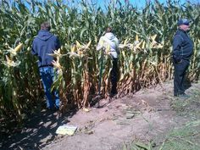
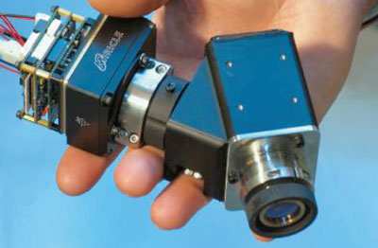
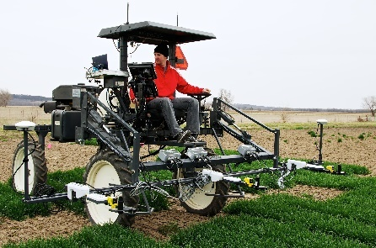
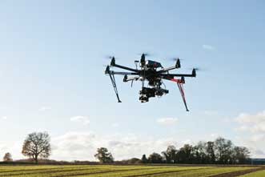
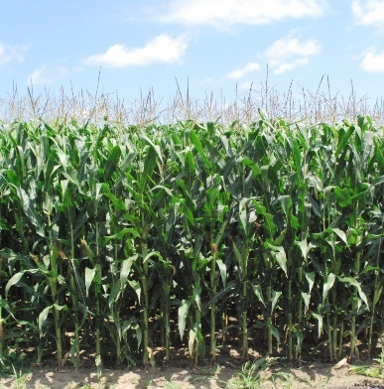
Introduction
Reflectance
Absorbance

Slide 7
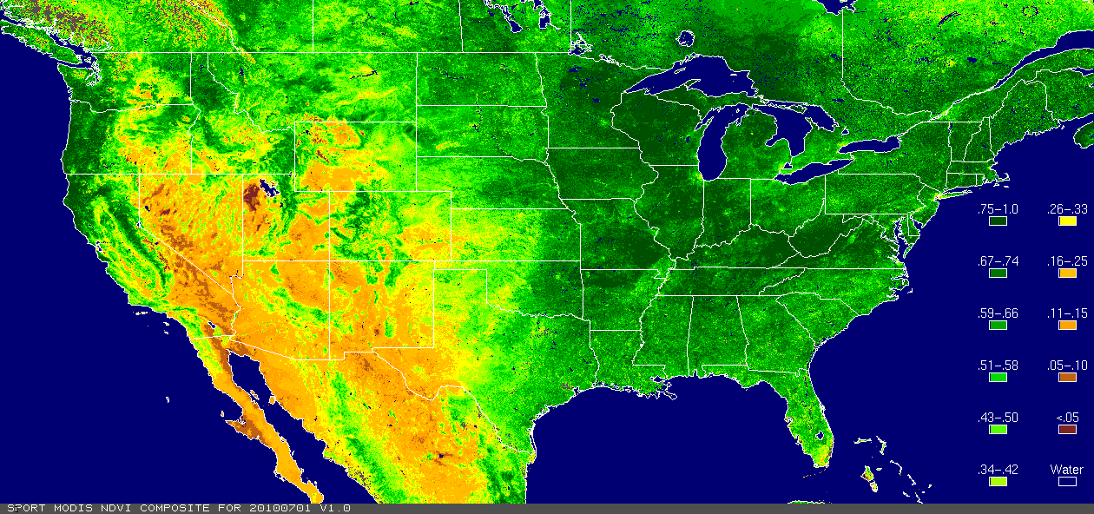

Introduction
Normalized Difference Vegetation Index | NDVI | (R₈₀₀-R₆₇₀)/(R₈₀₀+R₆₇₀)
Canopy Water Mass Index | CWMI | R₈₅₀/R₇₂₅
Modified Normalized Difference | mND | (R₇₅₀-R₇₀₅)/(R₇₅₀+R₇₀₅-2*R₄₄₅)
Photochemical Reflectance Index | PRI | (R₅₃₁-R₅₇₀)/(R₅₃₁+R₅₇₀)
$$y \sim$$
400 nm
440 nm
480 nm
560 nm
680 nm
520 nm
600 nm
640 nm
720 nm
760 nm
840 nm
800 nm
880 nm

Slide 8
Objectives
To quantify the level of prediction accuracy that can be achieved using high-spectrum data for predicting maize yield
To compare the the predictive power of these models with the power achievable using Vegetation Indices.
To assess the benefits of combining data from multiple time-points.

Slide 9
Data
465 maize genotypes
12 trials (heat and drought stress & irrigated)
Analyzed trait: Grain yield (ton/ha)
Inputs: 62 reflectance bands (from 400 to 850 nm)
five time-points

Slide 10


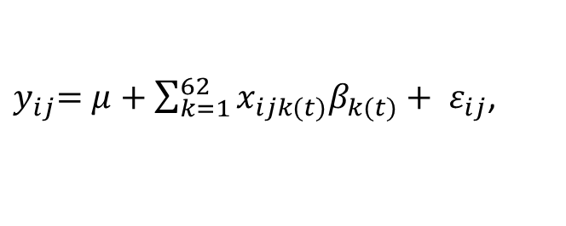
Methods
Single time point models
Index-regression:
PC- regression:
62-bands regression:
Models used for analyses.
 | Model ¹ | Inputs ² | # of inputs | Estimation method
Index-regression:
 | NDVI | (R₈₀₀-R₆₇₀)/(R₈₀₀+R₆₇₀) | 1 | OLS
 | CWMI | R₈₅₀/R₇₂₅ | 1 | OLS
 | mND | (R₇₅₀-R₇₀₅)/(R₇₅₀+R₇₀₅-2*R₄₄₅) | 1 | OLS
 | PRI | (R₅₃₁-R₅₇₀)/(R₅₃₁+R₅₇₀) | 1 | OLS
PC-regression:
 | PC | Five PC derived from 62 bands | 5 | OLS
62-bands regression:
 | OLS | 62 bands | 62 | OLS
 | BB | 62 bands | 62 | Bayes B
¹ NDVI = Normalized Difference Vegetation Index; CWMI = Canopy Water Mass Index; mND = Modified Normalized Difference at 705nm; PRI = Photochemical Reflectance Index; OLS = Ordinary Least Squares estimation; PC = Principal Components; BB = Bayes B Bayesian linear regression.
² For the VIs, subindex in formula indicate wavelength (nm).

Slide 11
Methods
Multi-time point models
Software
incorporating in the regression inputs multiple time points.
For model BB, different regularization parameters (scales and proportions of non-null effects) were estimated for each time point.
R (version 3.2.3)
Functions:
- lm() for OLS regressions
- BGLR() for Bayesian model (BB)

Slide 12
Methods
Model assessment
- Full-data analysis: Models fitted to the entire data set, to evaluate goodness of fit to the training data.
- Leave-one-trial-out: Cross validation with trials assigned to testing partitions (ability of the fitted equation to predict in a future trial).
Prediction accuracy with confident intervals:
-Across-trial correlations
-Within-trial correlations

Slide 13
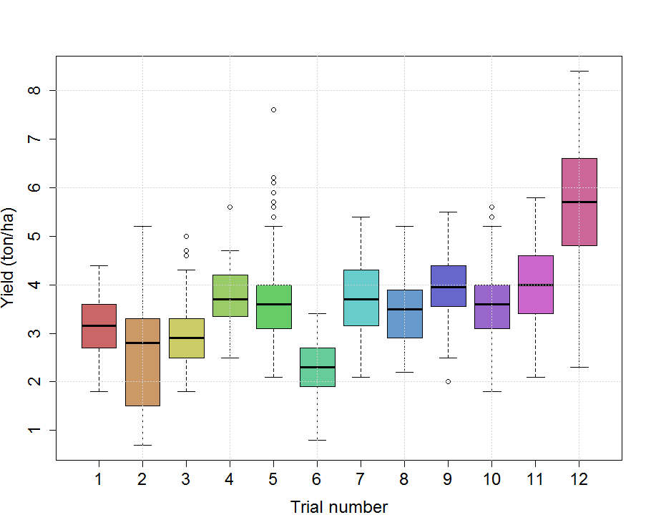
Results
Median yield trial ranged from 2.3 to 5.7 ton/ha

Slide 14
Results
Median yield trial ranged from 2.3 to 5.7 ton/ha
Average standard deviation: 0.78 ton/ha
0.78 * 3 = 2.34

Slide 15
Results
Median yield trial ranged from 2.3 to 5.7 ton/ha
Average standard deviation: 0.78 ton/ha
Grain yield had a relatively symmetric distribution (except in trial 2).

Slide 16
Results
Median yield trial ranged from 2.3 to 5.7 ton/ha
Average standard deviation: 0.78 ton/ha
Grain yield had a relatively symmetric distribution (except in trial 2).
Trial 12 with highest mean & median and larger variance.

Slide 17
Results
Median yield trial ranged from 2.3 to 5.7 ton/ha
Average standard deviation: 0.78 ton/ha
Grain yield had a relatively symmetric distribution (except in trial 2).
Trial 12 with highest mean and larger variance.
Trial 6 lowest mean and variance.

Slide 18
Results
225
221
Median yield trial ranged from 2.3 to 5.7 ton/ha
Average standard deviation: 0.78 ton/ha
Grain yield had a relatively symmetric distribution (except in trial 2).
Trial 12 with highest mean and larger variance.
Trial 6 lowest mean.
Biggest trials: 5 and 12
30
30

Slide 19
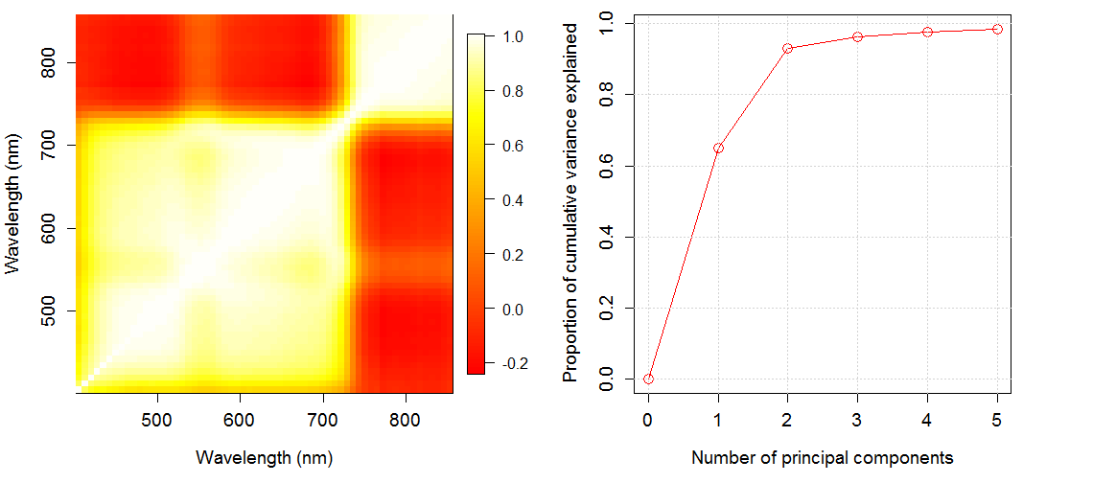
Results
NIR
Sample correlation of 62 bands at T5
Reflectance bands clustered in two groups.
Visible Spectrum
The leading eigenvalue explained 64% of the total variance.
The first 5 PCs explained 98% of the variance

Slide 20
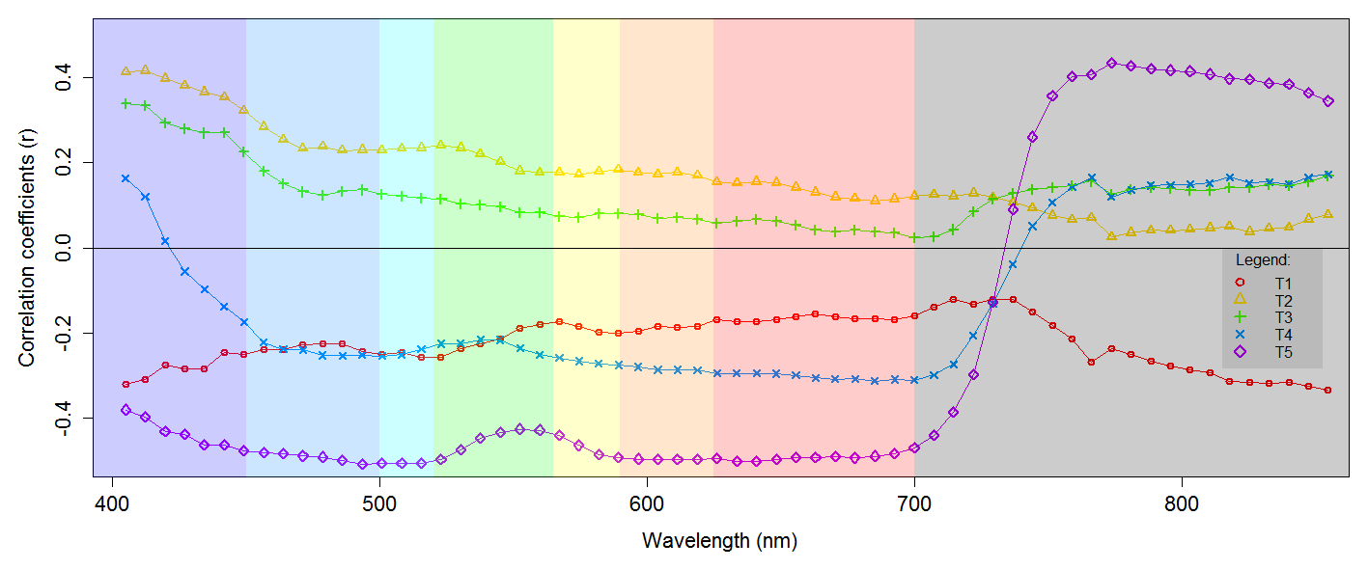
Results
Marginal correlation ranges from -0.51 to 0.43

Slide 21
Results
Marginal correlation ranges from -0.51 to 0.43
T5 had the highest averaged absolute marginal correlation

Slide 22
Results
Marginal correlation ranges from -0.51 to 0.43
T5 had the highest averaged absolute marginal correlation
T4 and T5 had negative correlation in the visible spectrum and positive in the NIR

Slide 23
Results
Marginal correlation ranges from -0.51 to 0.43
T5 had the highest averaged absolute marginal correlation
T4 and T5 had negative correlation in the visible spectrum and positive in the NIR
Low absolute correlation between 730 and 740 nm

Slide 24
Results
Marginal correlation ranges from -0.51 to 0.43
T5 had the highest averaged absolute marginal correlation
T4 and T5 had negative correlation in the visible spectrum and positive in the NIR
Low absolute correlation between 730 and 740 nm
Lowest absolute correlation: T3

Slide 25
Results
Correlations within trials were lower
+
-
+
-

Slide 26
Results
Correlations within trials were lower
Overall, multiple predictors models (PC, OLS, BB) fit better than index-based models.
-
+

Slide 27
Results
Correlations within trials were lower
Overall, models using multiple predictors (PC, OLS, BB) fitted better than index-based models.
CV correlations were lower (ranged from 0.04 to 0.64)
+
-

Slide 28
Results
Correlations within trials were lower
Overall, models using multiple predictors (PC, OLS, BB) fitted better than index-based models.
CV correlations were lower (ranged from 0.04 to 0.64)
Among the VI, mND had the best predictive performance
OLS and BB models performed similar

Slide 29
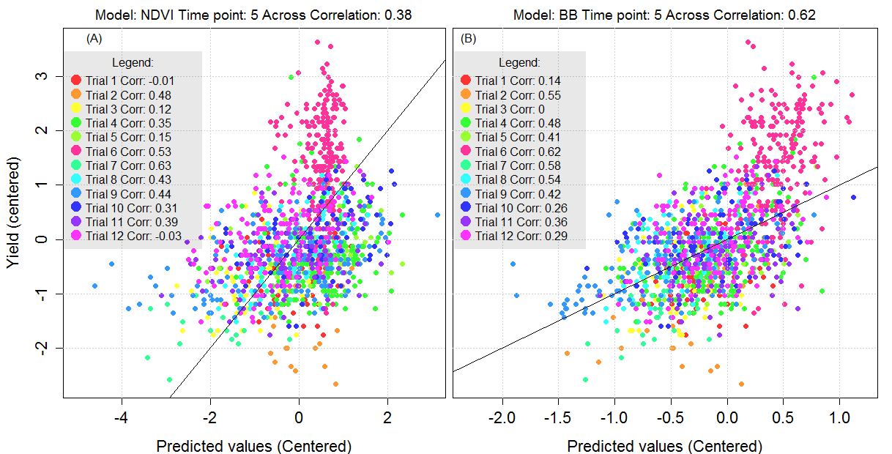
Results
Within trial correlations ranged from nearly 0 to 0.63

Slide 30
Results
-
+
-
+
+
-
-
+
-
+
-
+
+
-
-
+
+
-
+
-
+
-
-
+
Within trial correlations ranged from nearly 0 to 0.63
BB model had higher correlations in 7 of the 12 trials

Slide 31
Results
Within trial correlations ranged from nearly 0 to 0.63
BB model had higher correlations in 7 of the 12 trials
Trial 1 and 3 were poorly predicted

Slide 32
Results
Within trial correlations ranged from nearly 0 to 0.63
BB model had higher correlations in 7 of the 12 trials
Trial 1 and 3 were poorly predicted
Trial 12 have higher mean and dispersion

Slide 33
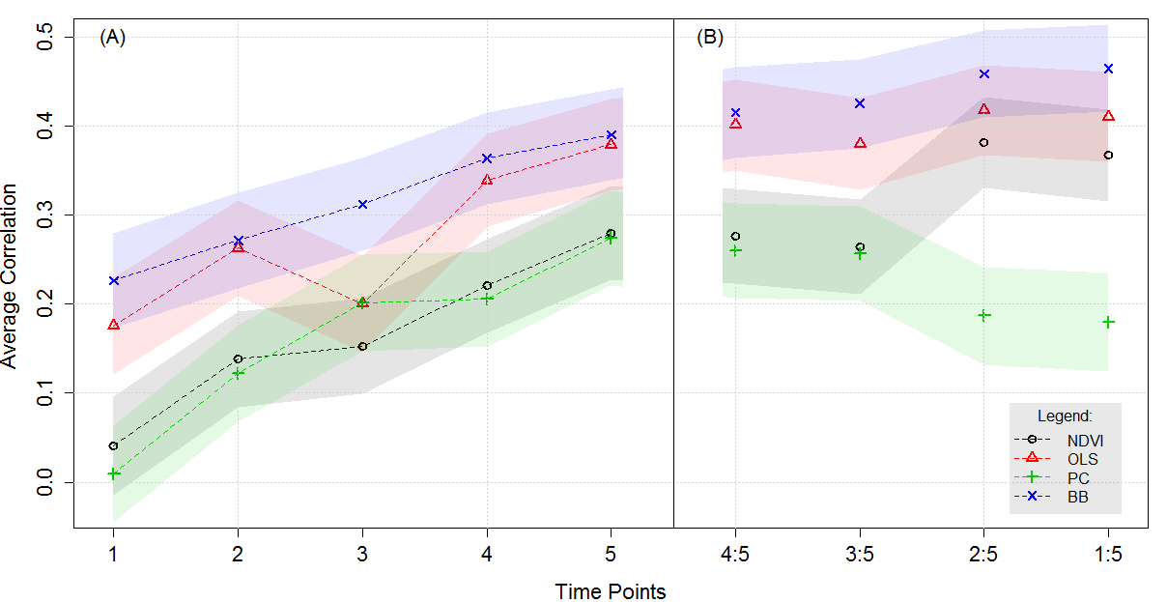
Results
Average within trial CV correlation increased from T1 to T5 with exception of T3

Slide 34
Results
Average within trial CV correlation increased from T1 to T5 with exception of T3
BB model had the best predictive performance across time points.

Slide 35
Results
Average within trial CV correlation increased from T1 to T5 with exception of T3
BB model had the best predictive performance across time points.
Combining data from multi-time points gave marginal gains in prediction accuracy for BB, no clear gains for OLS, and not beneficial for PC-regressions.

Slide 36
Conclusions
Clear advantages of using reflectance intensities from all available bands
Despite the explained 98% of the variance, PC model leads to a loss of prediction accuracy
OLS and BB performed similarly; however BB was more stable across time points and less prone to over-fitting.

Slide 37
Conclusions
Prediction accuracy increased from T1 to T5
data from multiple time points may lead to small gains in prediction accuracy
Further research needed to establish whether separate equations need to be fitted for contrasting environmental conditions

Slide 38



Acknowledgements
Thanks to Sam T., Jose C. and Juan B.
Thanks to Gustavo!

